Slide 1
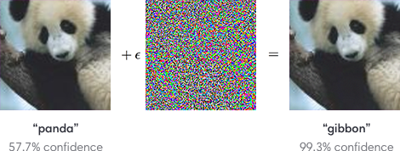
LX Adversarial Attacks
Z. Gu 2021

Slide 2
Outline
Adversarial examples
White-box attacks
Black-box attacks
Real-world attacks
Adversarial training

Slide 3
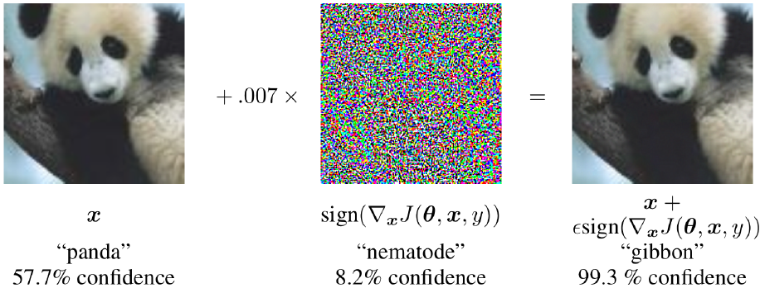
An Adversarial Example
Starting with an image of a panda, the attacker adds a small perturbation that has been calculated to make the image be recognized as a gibbon with high confidence.
https://openai.com/blog/adversarial-example-research/

Slide 4
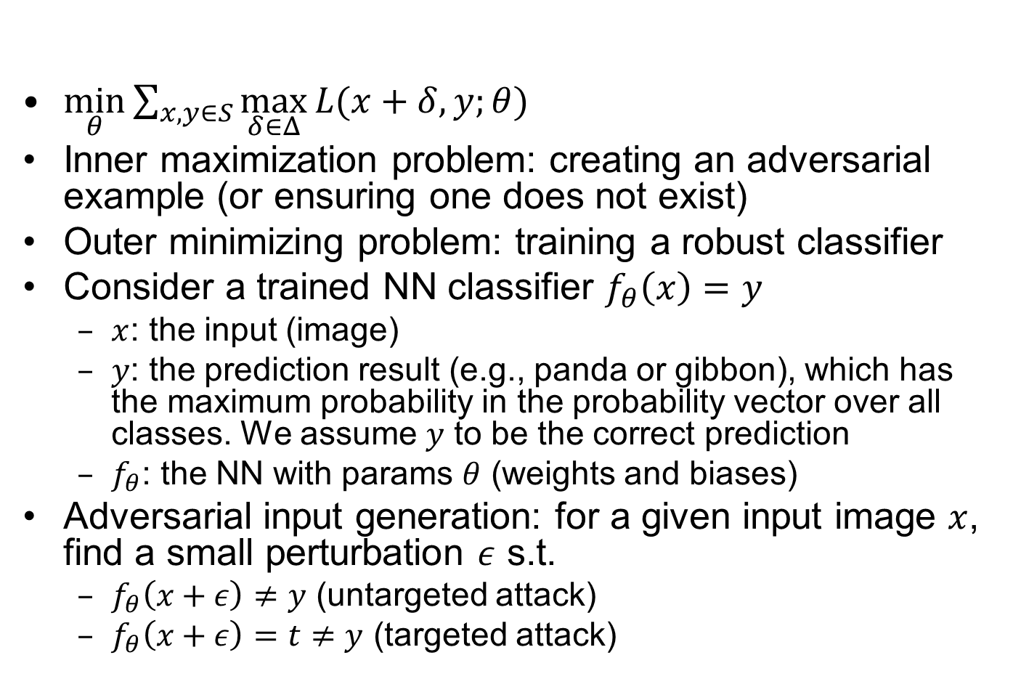
Problem Formulation
$\min_{θ}{\sum_{x,y∈S}{\max_{δ∈Δ}{L(x+δ,y;θ)}}}$
Inner maximization problem: creating an adversarial example (or ensuring one does not exist)
Outer minimizing problem: training a robust classifier
Consider a trained NN classifier $f_{θ}\left(x\right)=y$
$x$: the input (image)
$y$: the prediction result (e.g., panda or gibbon), which has the maximum probability in the probability vector over all classes. We assume $y$ to be the correct prediction
$f_{θ}$: the NN with params $θ$ (weights and biases)
Adversarial input generation: for a given input image $x$, find a small perturbation $ε$ s.t.
$f_{θ}\left(x+ε\right)≠y$ (untargeted attack)
$f_{θ}\left(x+ε\right)=t≠y$ (targeted attack)
Notes:
($C\left(x\right)={argmax}_{i}{y_{i}}$) (assuming a SoftMax classifier)

Slide 5

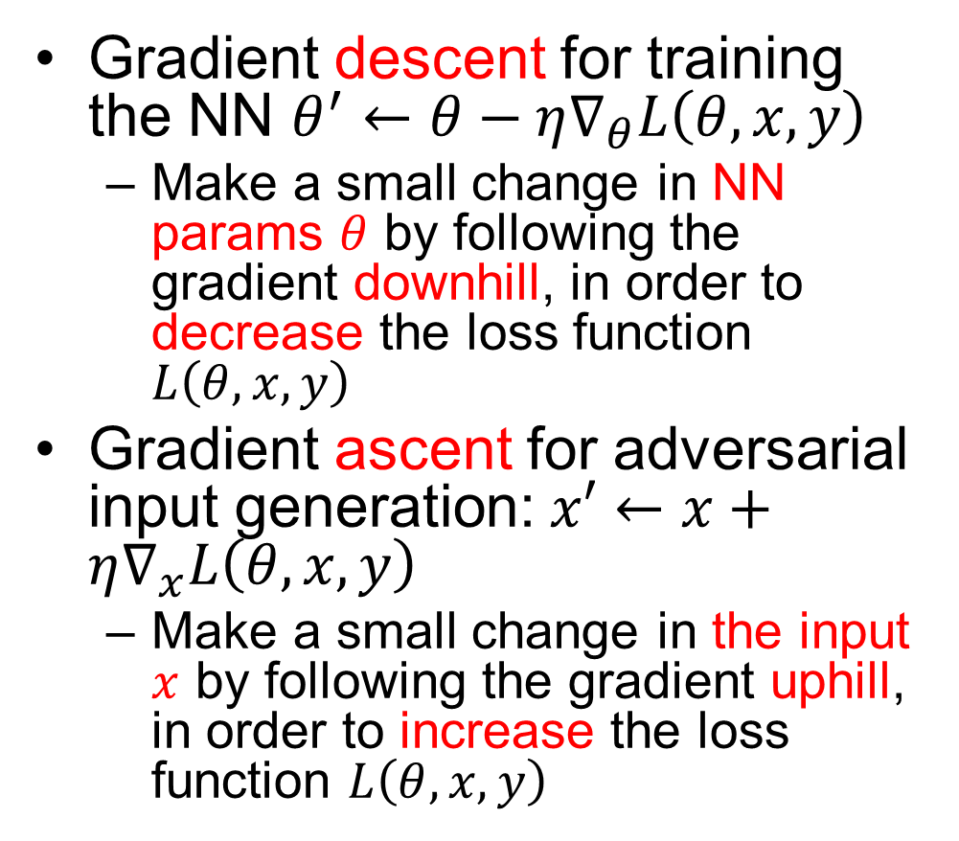



NN Training vs. Adversarial Input Generation
Gradient descent for training the NN $θ^{′}←θ−η∇_{θ}L\left(θ,x,y\right)$
Make a small change in NN params $θ$ by following the gradient downhill, in order to decrease the loss function $L\left(θ,x,y\right)$
Gradient ascent for adversarial input generation: $x′←x+η∇_{x}L\left(θ,x,y\right)$
Make a small change in the input $x$ by following the gradient uphill, in order to increase the loss function $L\left(θ,x,y\right)$
$$L\left(θ,x,y\right)$$
$$θ$$
$$L\left(θ,x,y\right)$$
$$x$$

Slide 6
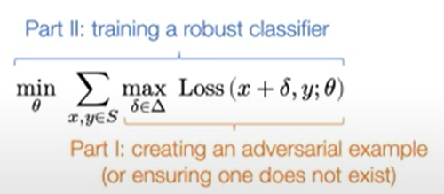
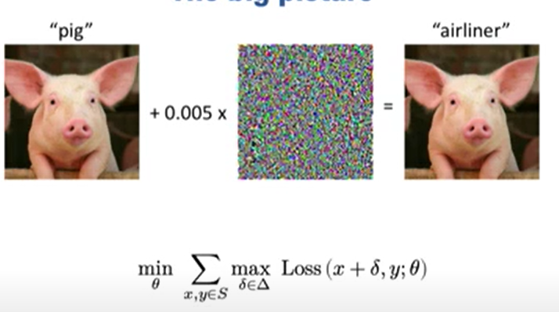

Slide 7
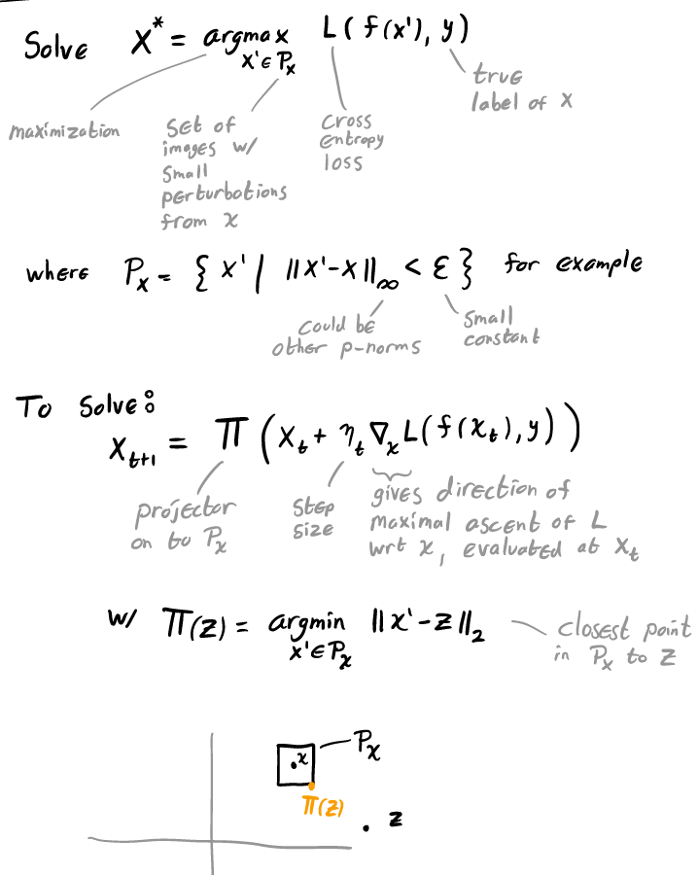
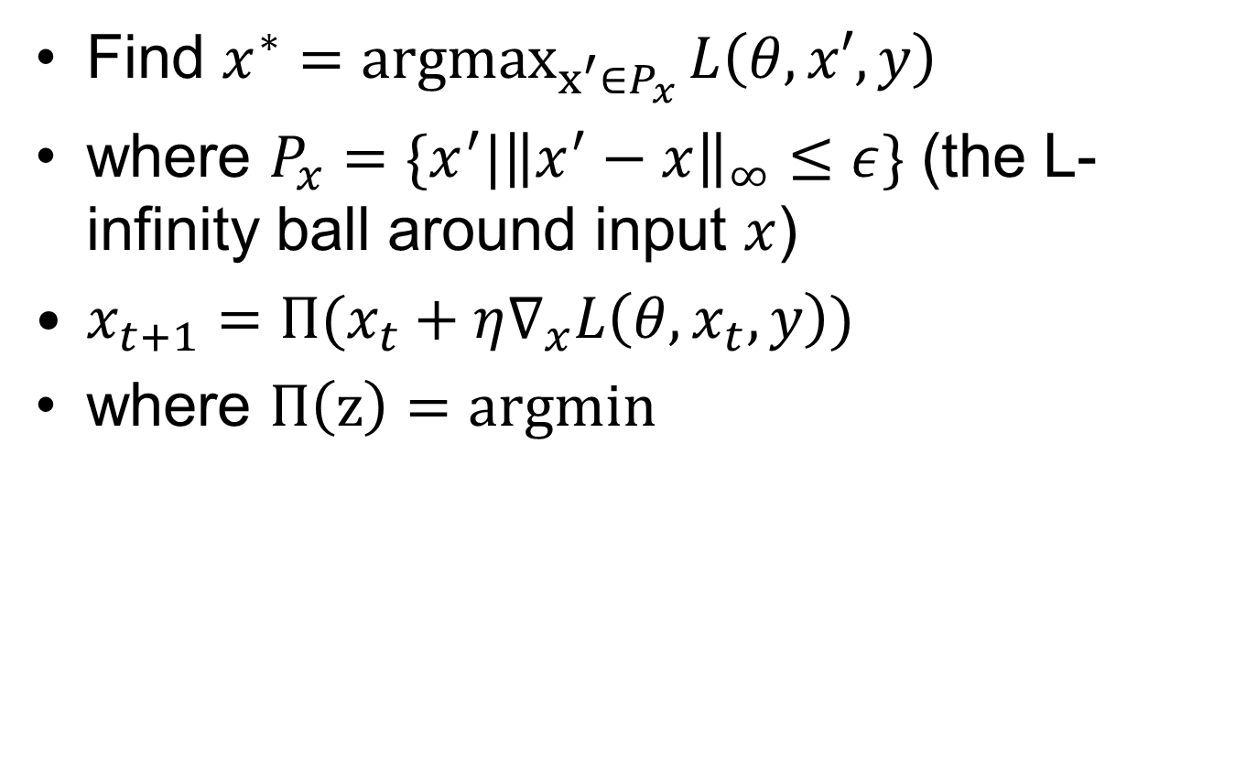
Projected Gradient Descent (PGD)
Find $x^{∗}={argmax}_{x^{′}∈P_{x}}{L\left(θ,x′,y\right)}$
where $P_{x}=\{x^{′}|{\left\|x^{′}−x\right\|}_{∞}≤ε\}$ (the L-infinity ball around input $x$)
$x_{t+1}=Π(x_{t}+η∇_{x}L\left(θ,x_{t},y\right))$
where $Π\left(z\right)=argmin$

Slide 8
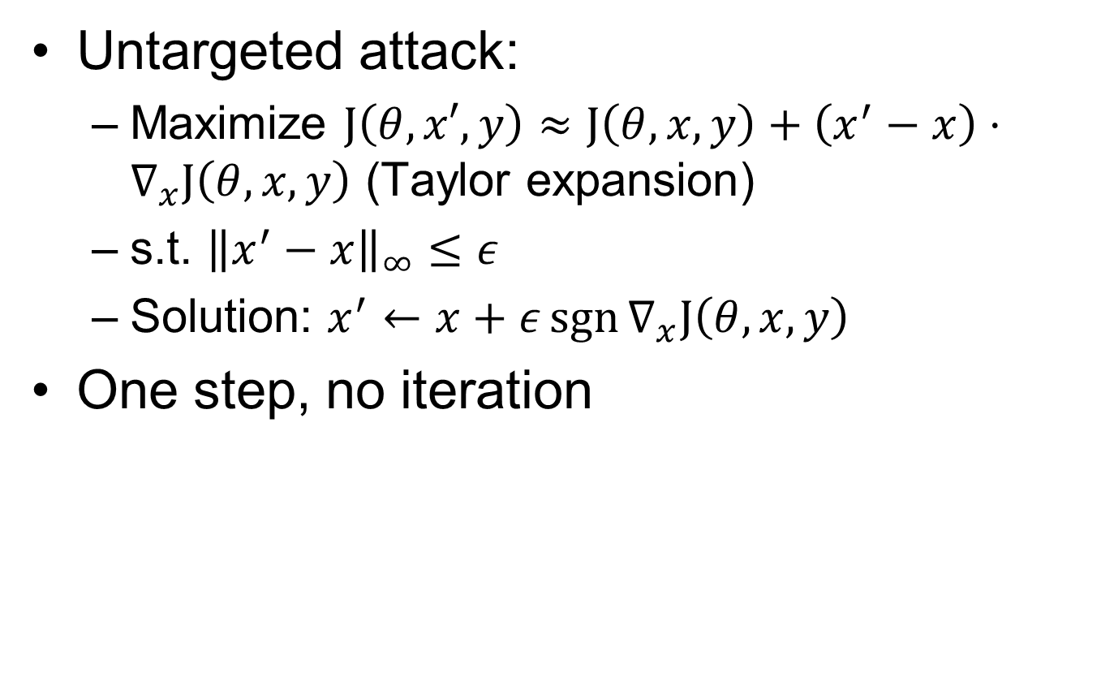
Fast Gradient Sign Method (FGSM)
Untargeted attack:
Maximize $J\left(θ,x′,y\right)≈J\left(θ,x,y\right)+\left(x^{′}−x\right)⋅∇_{x}J\left(θ,x,y\right)$ (Taylor expansion)
s.t. ${\left\|x^{′}−x\right\|}_{∞}≤ε$
Solution: $x^{′}←x+ε\operatorname{sgn}{∇_{x}J\left(θ,x,y\right)}$
One step, no iteration

